Slide 1

Selman Alpdundar
Extensions on Type Systems

Slide 2
Introduction - Covert Channels
Mechanisms for signalling information through a computing system are known as channels.
Channels that exploit a mechanism whose primary purpose is not information transfer are called covert channels; they pose the greatest challenge in preventing improper information leaks.

Slide 3
Cover Channels
Implicit Flows (was implemented by Selman Alpdundar)
Termination Channels ()
Timing Channels
Probabilistic Channels ( was Implemented by Laura Bussi)
Resource Exhaustion Channels
Power Channels

Slide 4
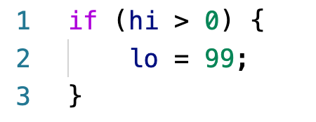
Implicit Flows – Leak 1
“Leaks the sign of guard, not its value”
There is a leak here, because the type system allow usage of lower secret label under high guard.

Slide 5
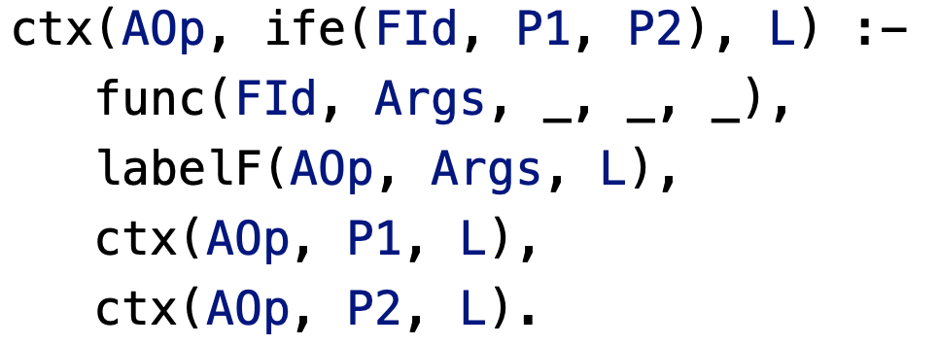
Implicit Flows – Solution 1
The problem solved during the implementation in class by enforcing then and else
part having same secret label.

Slide 6
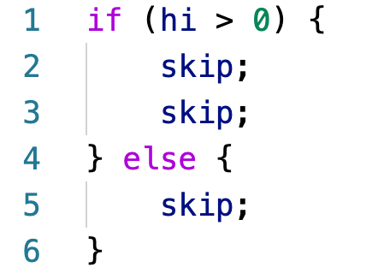
Implicit Flows – Leak 2
“Leaks the sign of hi, not its value”
The problem is execution time, the attacker can get sign of hi because then and else part have
different execution time.

Slide 7
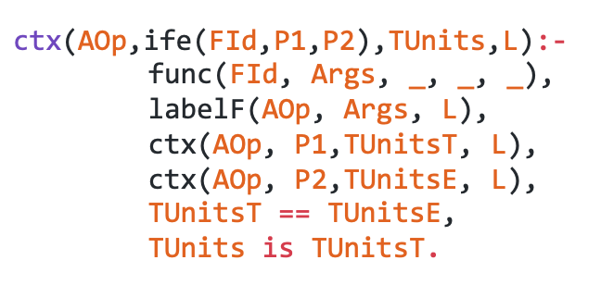
Implicit Flows – Solution 2
Solution is checking time units of then and else part but under then and else there could be another If then else, while loop, try catch, or sequential programs.
We need to change other indicator to be able to get sequential sum of programs.

Slide 8
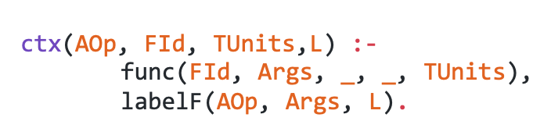
Implicit Flows – Solution 2 - Program
Just get time unit of function and assign it as time unit of program

Slide 9
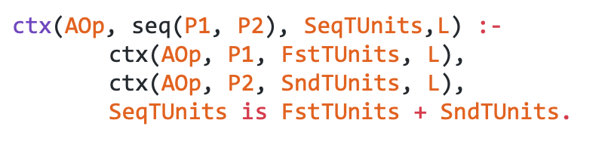
Implicit Flows – Solution 2 – Sequential Program
Sum up time units of first and second program and assign it as sequential time units

Slide 10
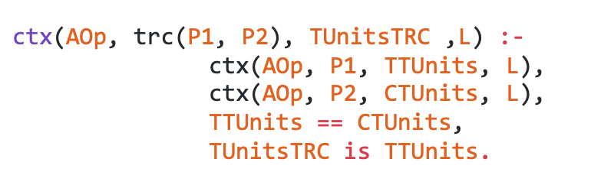
Implicit Flows – Solution 2 – Try Catch
We assumed try and catch have same logic with the if then else, therefore, we checked time units of try and catch and assigned time units of try as time units of try catch.

Slide 11
Implicit Flows – Solution 2 – While ?

Slide 12
Termination Channels - Leak

